Slide 1


Online Safety Workshop
For Parents and Carers

Slide 2

Computing team at Lozells primary school
Mrs Montaque
Computing Subject Lead
Mr Iqbal
IT Manager

Slide 3
Aim of the session
How children are engaging and interacting with the online world
Online Safety Risks
Online safety at Lozells Primary School
Further advice and support

Slide 4
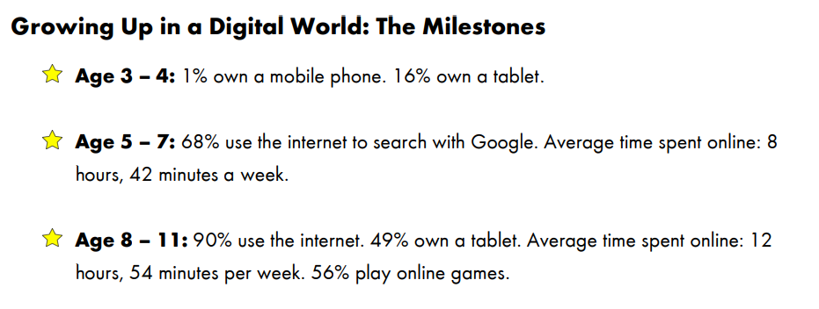

Slide 5
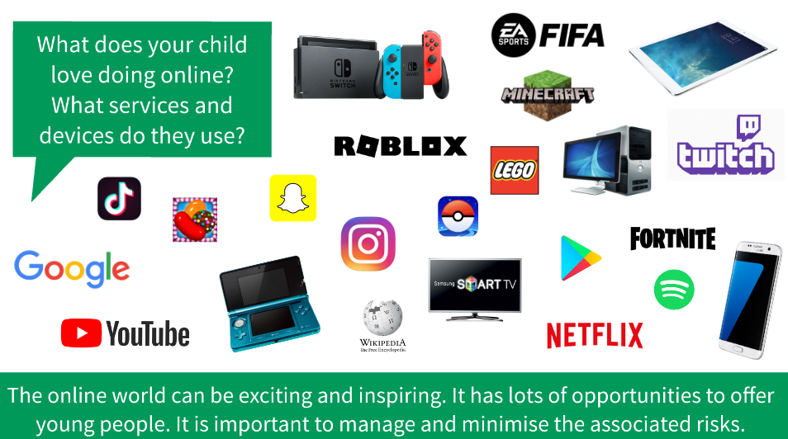
How children are engaging with the online world?
Notes:
The online world varies and changes all the time. It began with the internet, but there are a number of devices that children can use to get online. This is not an exhaustive list and the platofmrs, apps, games and social media sites that they can access keeps evolving. For many children it is exciting but with it comes risk, which we all have a part to plahy in helping to minimize these risks

Slide 6
Some commons concerns around keeping children safe online include:
‘I’m concerned that my child is being cyberbullied.’
‘I think my child is viewing inappropriate content online.’
‘I think my child is cyberbullying another student online.’
‘My child is spending too much time playing online games.’
‘I’m worried about the pressures of social media.’
‘I don’t know who my child is talking to online.’

Slide 7



Online Safety Factors
Conduct - children's online behaviour
Content - what children see, receive and share
Contact - who children communicate with

Slide 8
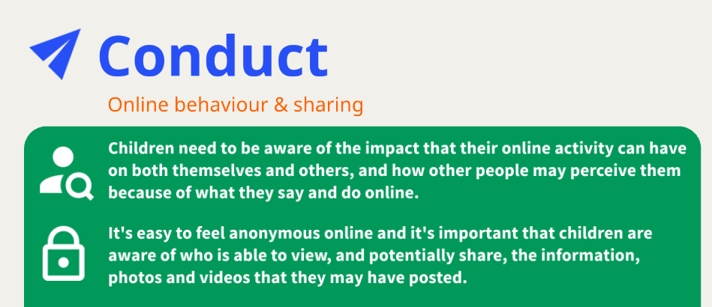

Slide 9
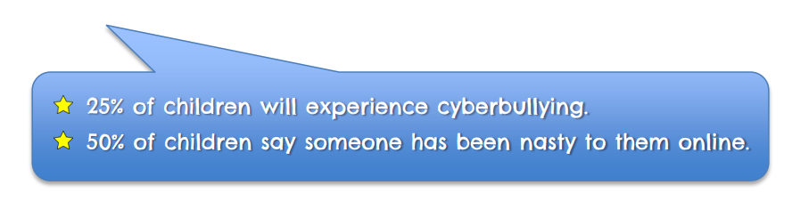
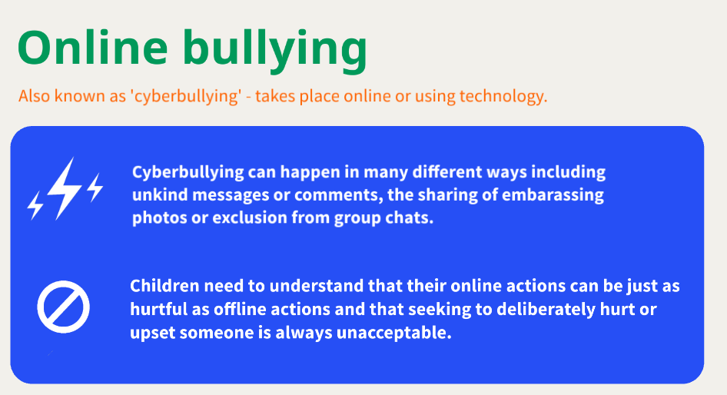
Conduct
Notes:
Children should be aware of what to look out for in other peoples conduct but also their own
Important to note that there are other online cuber bullying

Slide 10
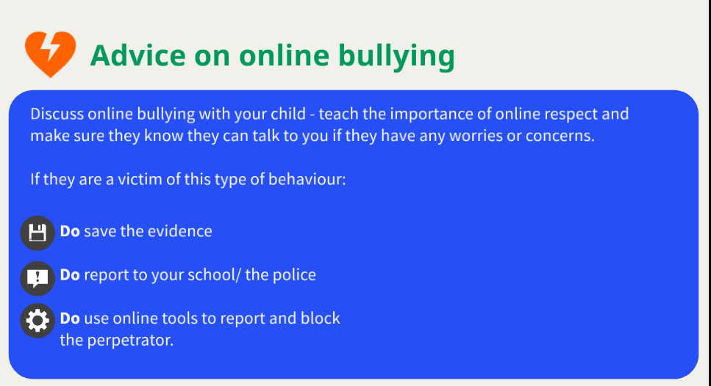

Slide 11
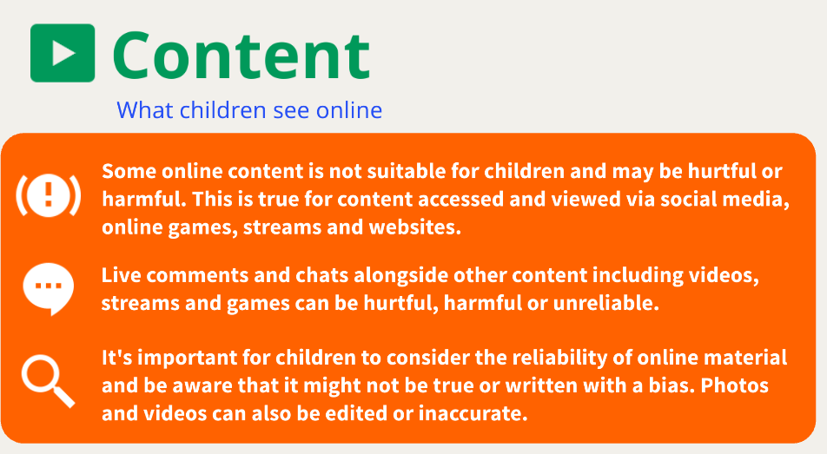

Slide 12
Content - What they receive and send
Children may be writing, creating or sending inappropriate content. The sending of nude, semi-nude images has become increasingly common and represents a very real challenge for young people. Incidents have involved children as young as seven.

Slide 13
Advice on content
Remind children that if they see anything that upsets them, or is inappropriate to talk to a trusted adult.
Discuss what information is okay to share online and what is not, and why. What we upload or send can be copied and circulated.

Slide 14
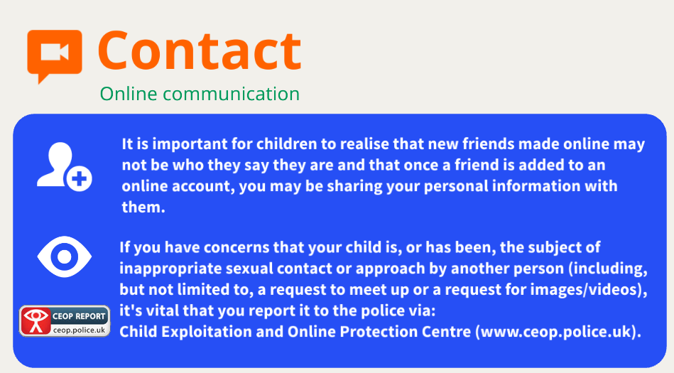

Slide 15
Grooming
Online grooming is when someone uses the the internet to build a relationship with a young person, with the intention of tricking, pressuring or forcing them into doing something inappropriate.
This can range from sharing images or taking part in other activities such as selling drugs or doing something illegal.
Someone could be groomed by someone they know, by a stranger or by a person they met online. That person could be older, the same age, or even someone who's in a position of authority

Slide 16
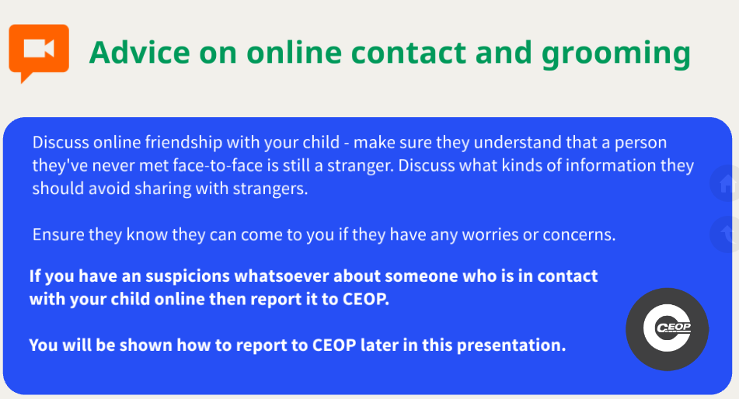

Slide 17
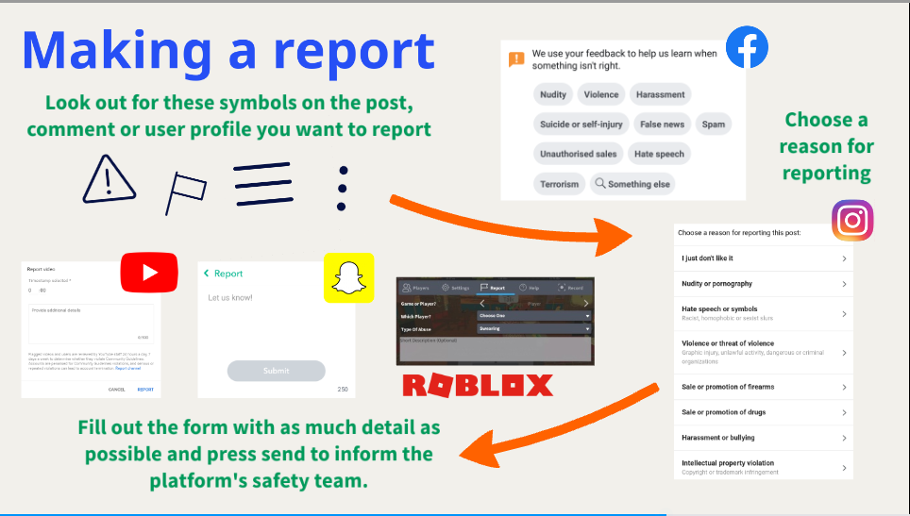


Slide 18



Online safety at Lozells Primary School
Online Safety is taught as part of our Computing Curriculum
Safer Internet Day - A global online safety initiative which is celebrated on the first Tuesday in February every year.
Online safety filtering - so we can identify and monitor children's online behaviours and address these where appropriate.

Slide 19
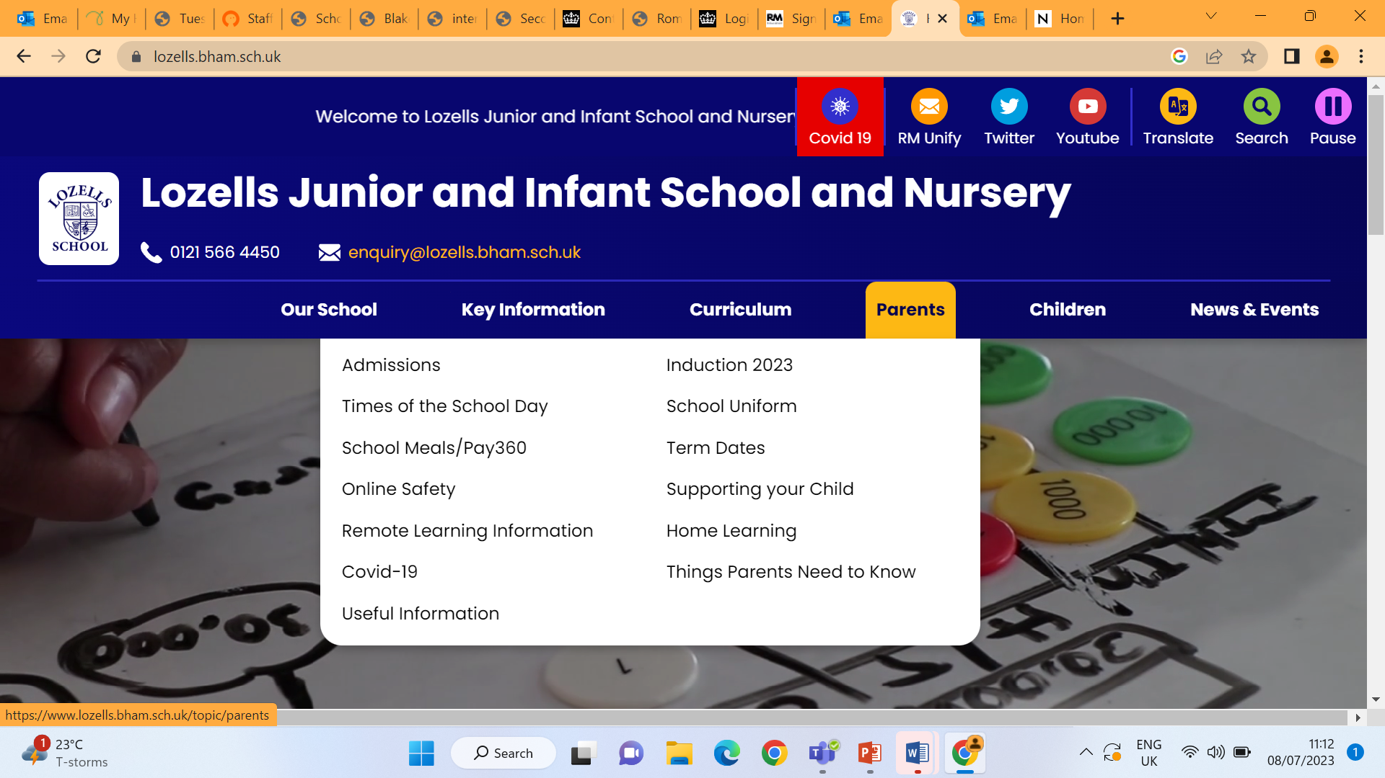

Slide 20
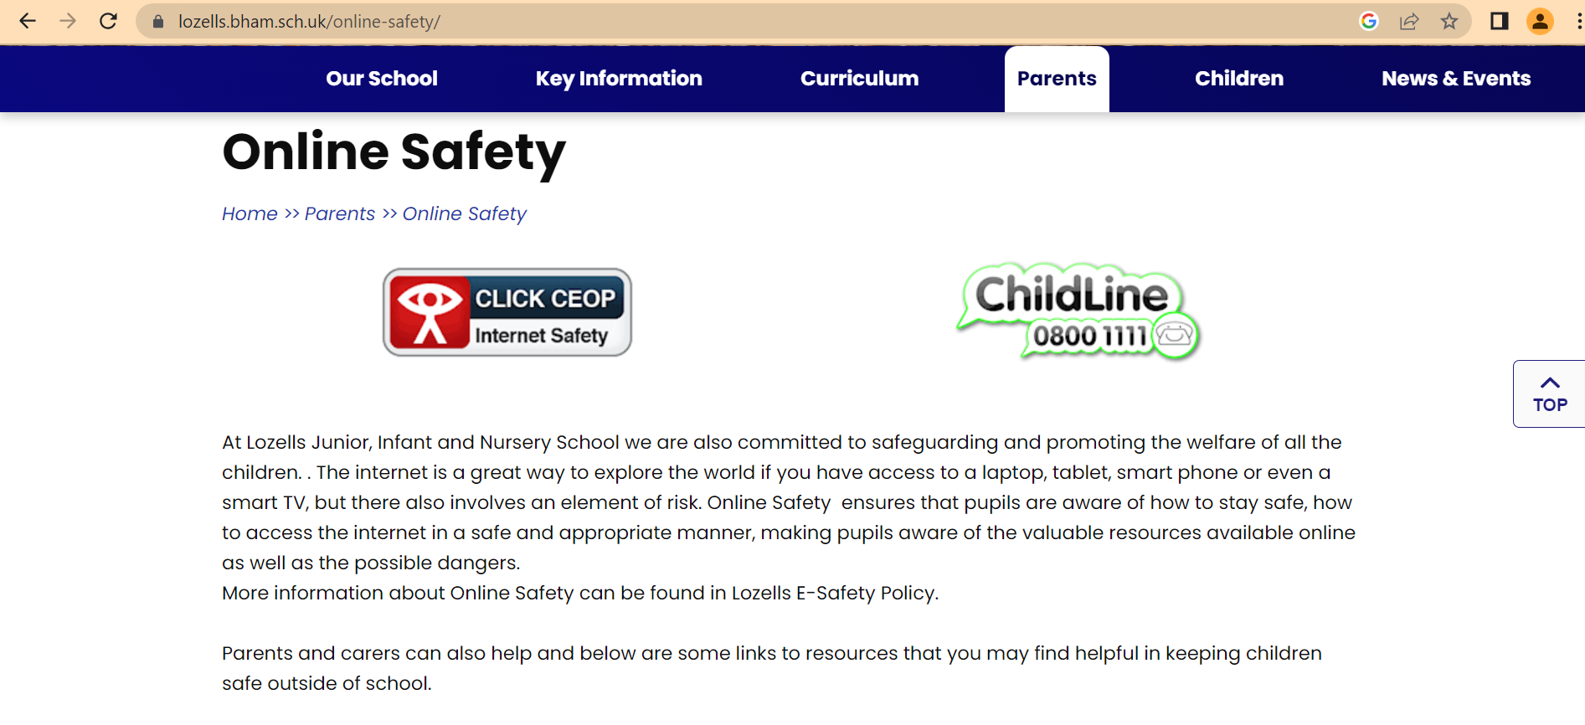

Slide 21
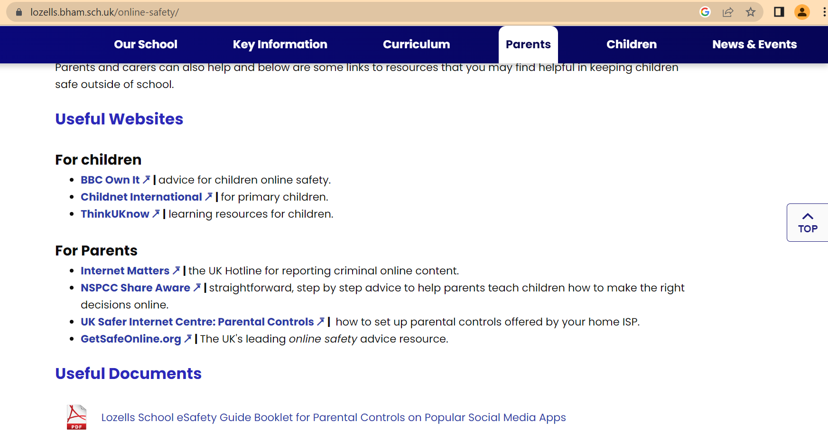

Slide 22
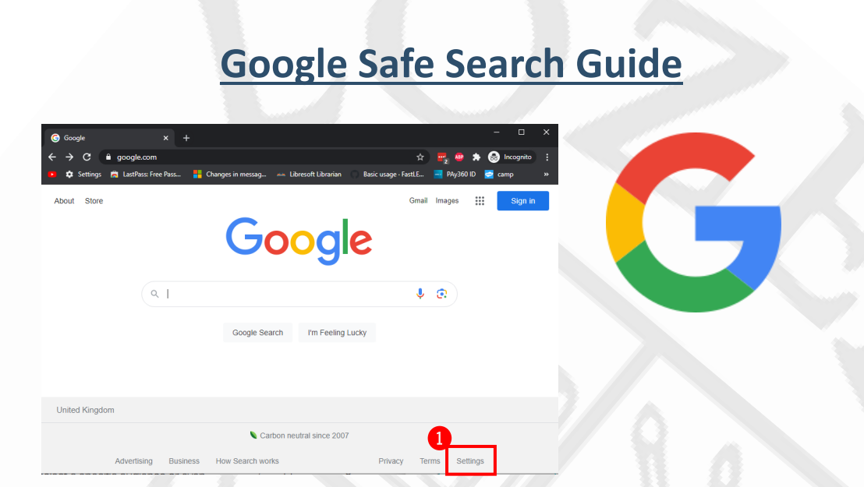
Online Safety and Settings Guide

Slide 23

If you do have any other concerns about your child's online safety, please speak to anyone at school.

Slide 24
